Slide 1
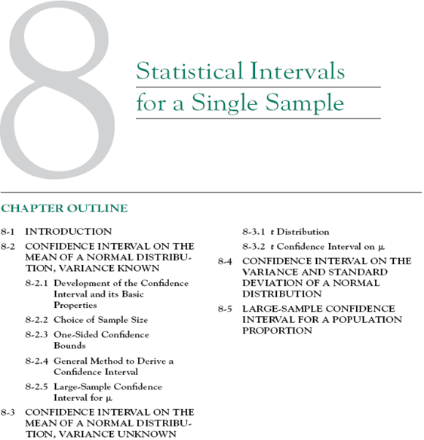
Notes:
0919639556

Slide 2
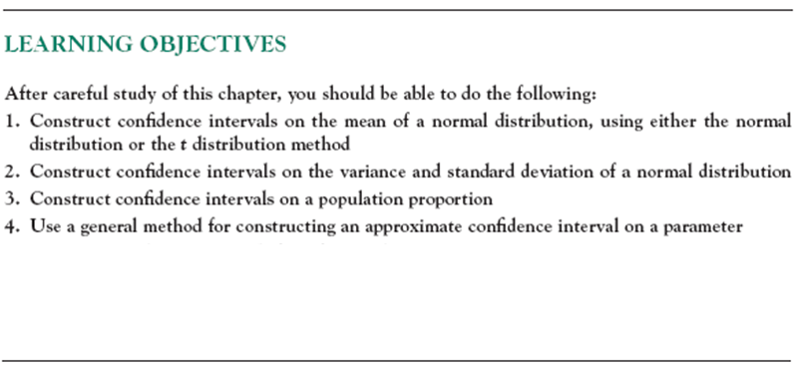

Slide 3
8-1 Introduction
In the previous chapter we illustrated how a parameter can be estimated from sample data. However, it is important to understand how good is the estimate obtained.
Bounds that represent an interval of plausible values for a parameter are an example of an interval estimate.
Three types of intervals will be presented:
    Confidence intervals
    Prediction intervals
    Tolerance intervals
Notes:
Plausible: hop li

Slide 4
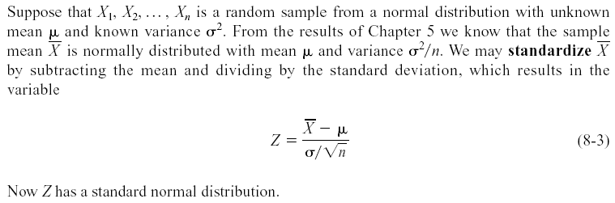
8-2 Confidence Interval on the Mean of a Normal Distribution, Variance Known
8-2.1 Development of the Confidence Interval and its Basic Properties

Slide 5
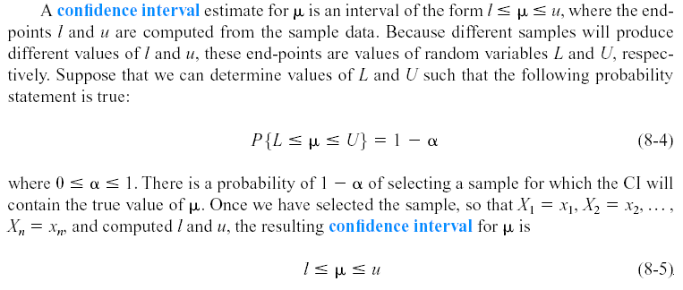
8-2 Confidence Interval on the Mean of a Normal Distribution, Variance Known
8-2.1 Development of the Confidence Interval and its Basic Properties

Slide 6
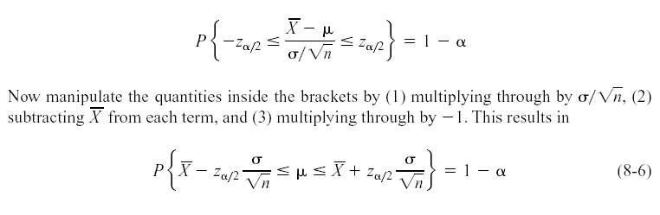
8-2 Confidence Interval on the Mean of a Normal Distribution, Variance Known
8-2.1 Development of the Confidence Interval and its Basic Properties
The endpoints or bounds l and u are called lower- and upper-confidence limits, respectively.
Since Z follows a standard normal distribution, we can write:

Slide 7
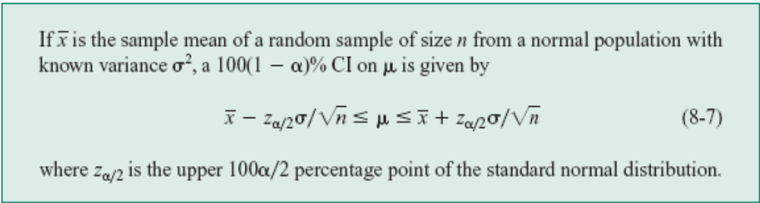
8-2 Confidence Interval on the Mean of a Normal Distribution, Variance Known
8-2.1 Development of the Confidence Interval and its Basic Properties
Definition

Slide 8
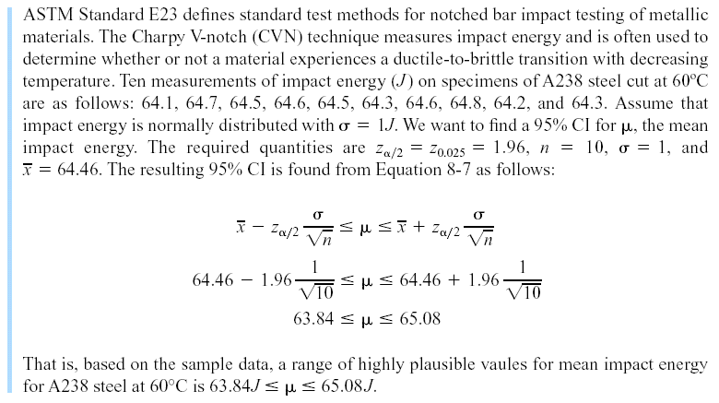
8-2 Confidence Interval on the Mean of a Normal Distribution, Variance Known
Example 8-1
Notes:
Ductile: mềm dễ kéo sợi
Brittle: giòn, dễ gãy

Slide 9
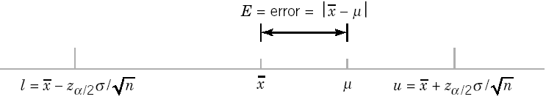

8-2 Confidence Interval on the Mean of a Normal Distribution, Variance Known
Confidence Level and Precision of Error
The length of a confidence interval is a measure of the precision of estimation.
Figure 8-2 Error in estimating μ with .
Notes:
Precision : do chinh xac

Slide 10
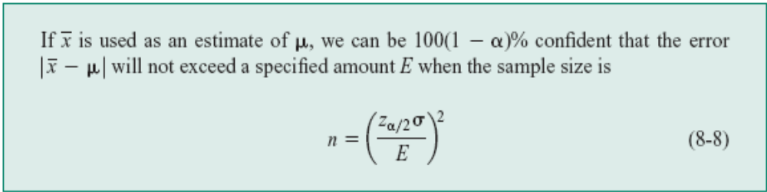
8-2 Confidence Interval on the Mean of a Normal Distribution, Variance Known
8-2.2 Choice of Sample Size
Definition

Slide 11
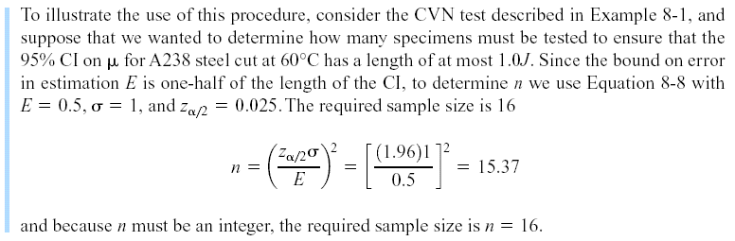
8-2 Confidence Interval on the Mean of a Normal Distribution, Variance Known
Example 8-2

Slide 12
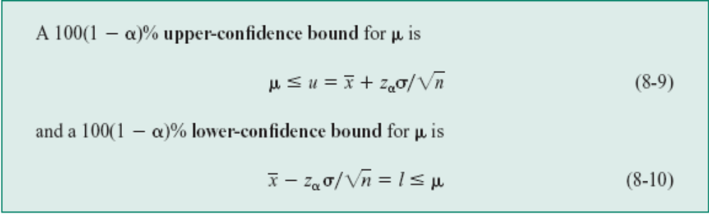
8-2 Confidence Interval on the Mean of a Normal Distribution, Variance Known
8-2.3 One-Sided Confidence Bounds
Definition

Slide 13
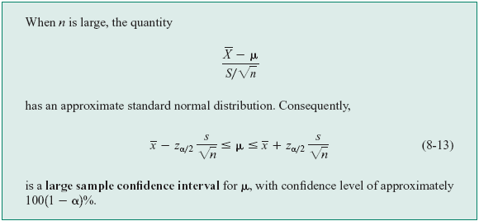
8-2 Confidence Interval on the Mean of a Normal Distribution, Variance Known
8-2.5 A Large-Sample Confidence Interval for μ
Definition

Slide 14
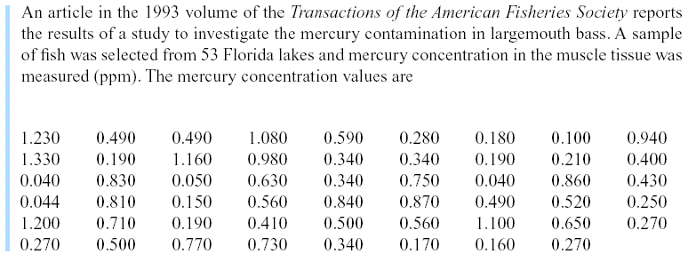
8-2 Confidence Interval on the Mean of a Normal Distribution, Variance Known
Example 8-4
Notes:
Mercury: thuyr ngaan;

Slide 15
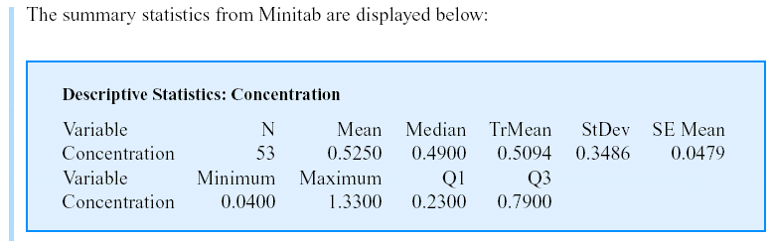
8-2 Confidence Interval on the Mean of a Normal Distribution, Variance Known
Example 8-4 (continued)

Slide 16
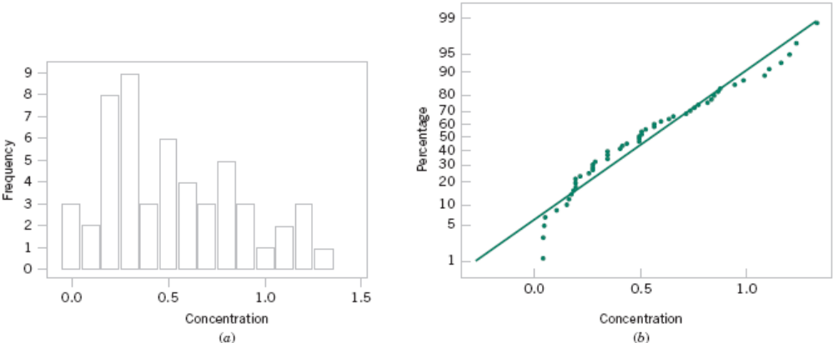
8-2 Confidence Interval on the Mean of a Normal Distribution, Variance Known
Example 8-4 (continued)
Figure 8-3 Mercury concentration in largemouth bass (a) Histogram. (b) Normal probability plot

Slide 17
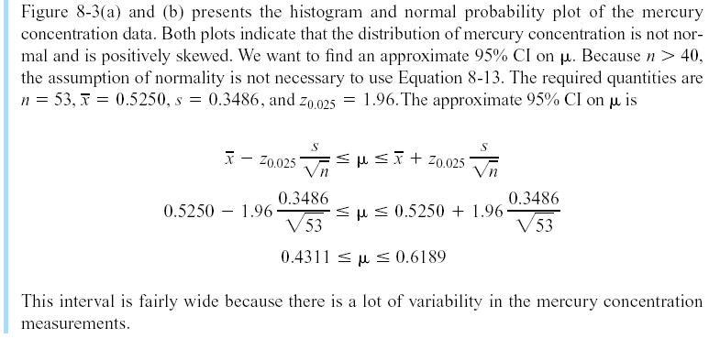
8-2 Confidence Interval on the Mean of a Normal Distribution, Variance Known
Example 8-4 (continued)
Notes:
Mercury: thuy ngan

Slide 18
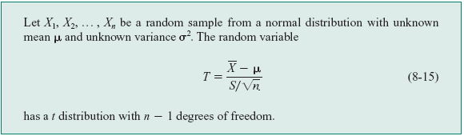
8-3 Confidence Interval on the Mean of a Normal Distribution, Variance Unknown
8-3.1 The t distribution

Slide 19
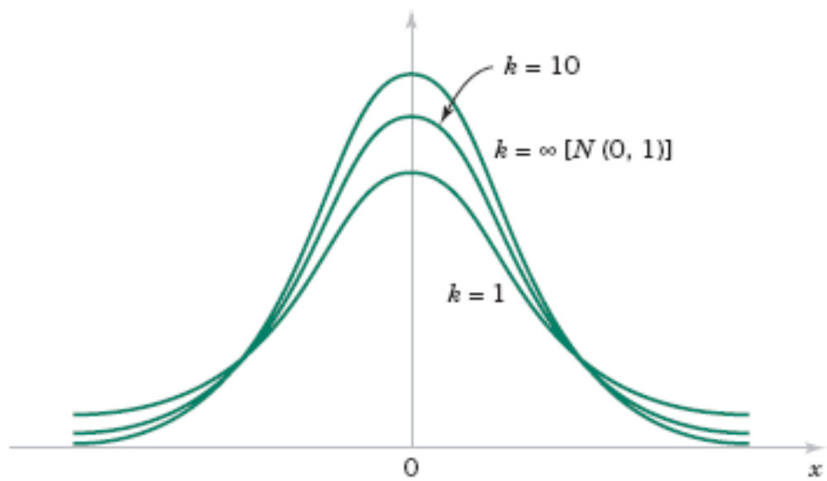
8-3 Confidence Interval on the Mean of a Normal Distribution, Variance Unknown
8-3.1 The t distribution
Figure 8-4 Probability density functions of several t distributions.

Slide 20
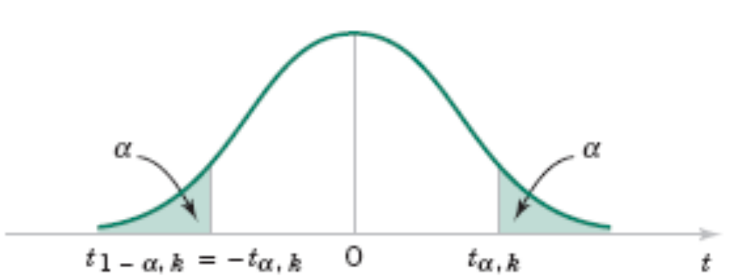
8-3 Confidence Interval on the Mean of a Normal Distribution, Variance Unknown
8-3.1 The t distribution
Figure 8-5 Percentage points of the t distribution.

Slide 21
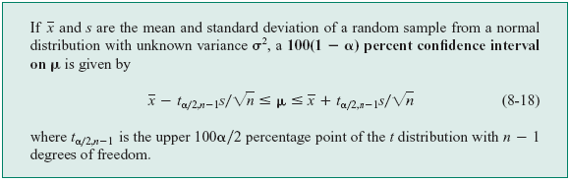
8-3 Confidence Interval on the Mean of a Normal Distribution, Variance Unknown
8-3.2 The t Confidence Interval on μ
One-sided confidence bounds on the mean are found by replacing t_{α/2,n-1} in Equation 8-18 with t _{α,n-1}.

Slide 22
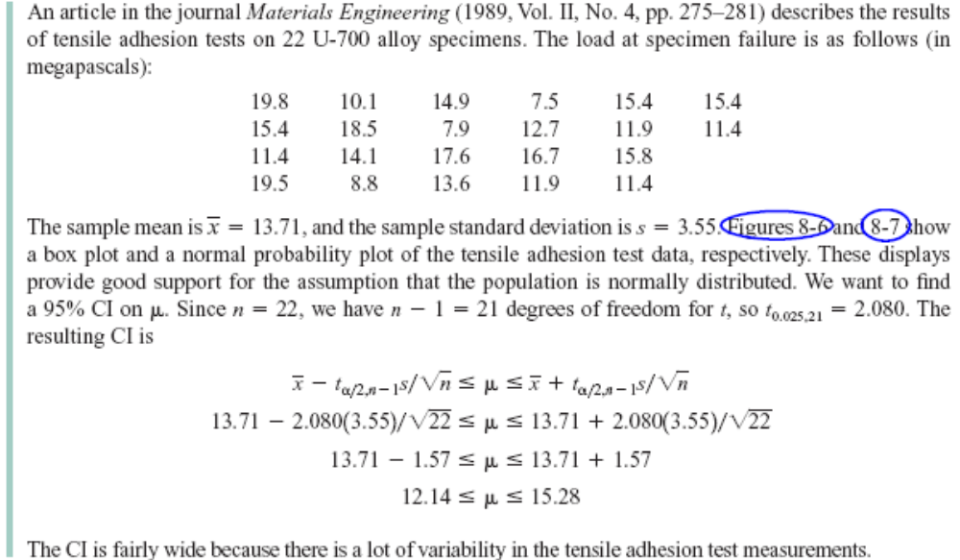
8-3 Confidence Interval on the Mean of a Normal Distribution, Variance Unknown
Example 8-5
Notes:
Tensile: suc cang; adhesion: su dinh chat vao; alloy: hop kim.

Slide 23
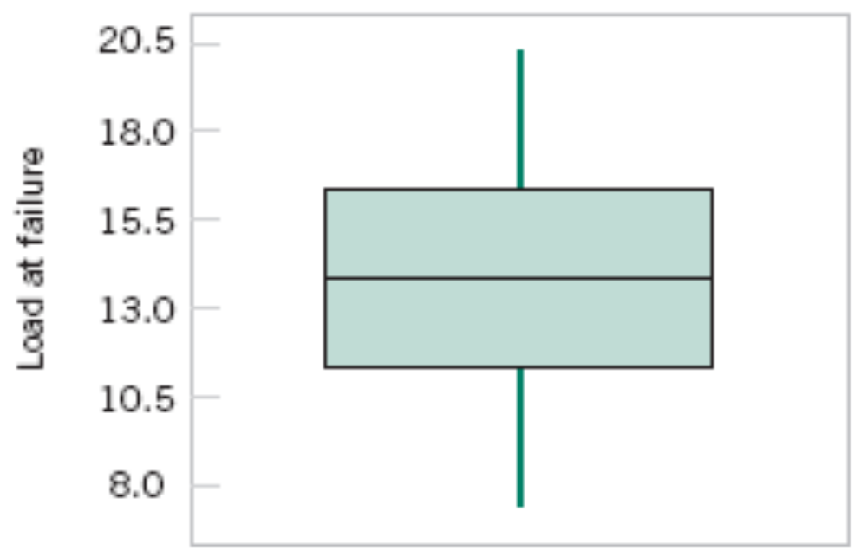
8-3 Confidence Interval on the Mean of a Normal Distribution, Variance Unknown
Figure 8-6 Box and Whisker plot for the load at failure data in Example 8-5.

Slide 24
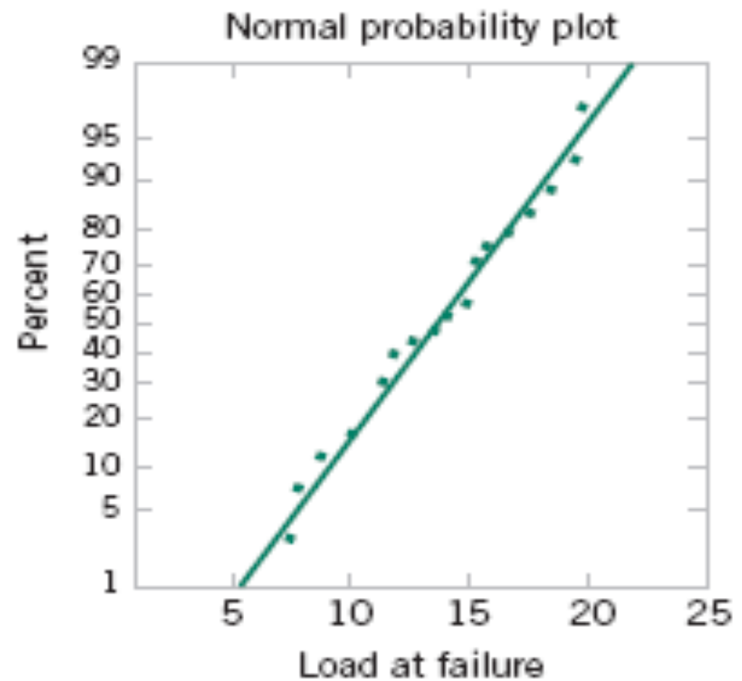
8-3 Confidence Interval on the Mean of a Normal Distribution, Variance Unknown
Figure 8-7 Normal probability plot of the load at failure data in Example 8-5.

Slide 25
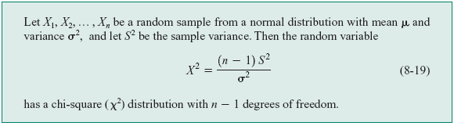
8-4 Confidence Interval on the Variance and Standard Deviation of a Normal Distribution
Definition

Slide 26
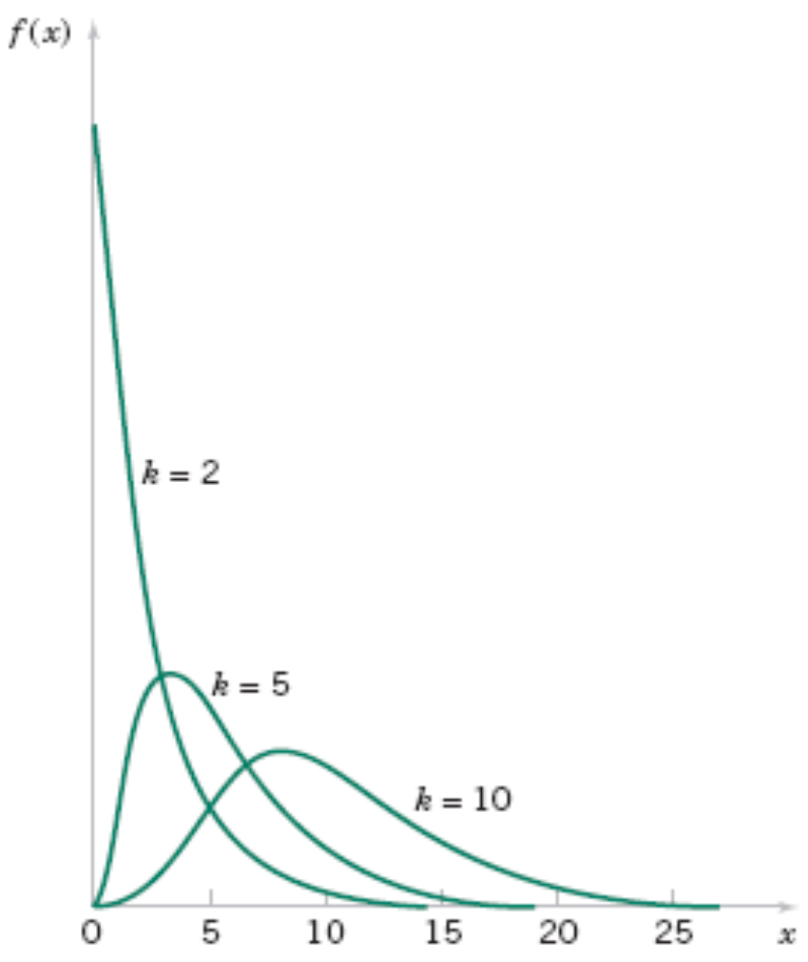
8-4 Confidence Interval on the Variance and Standard Deviation of a Normal Distribution
Figure 8-8 Probability density functions of several χ² distributions.

Slide 27
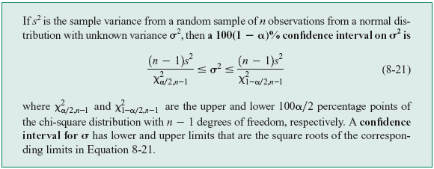
8-4 Confidence Interval on the Variance and Standard Deviation of a Normal Distribution
Definition

Slide 28
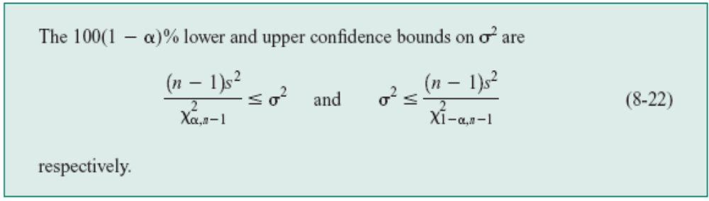
8-4 Confidence Interval on the Variance and Standard Deviation of a Normal Distribution
One-Sided Confidence Bounds

Slide 29
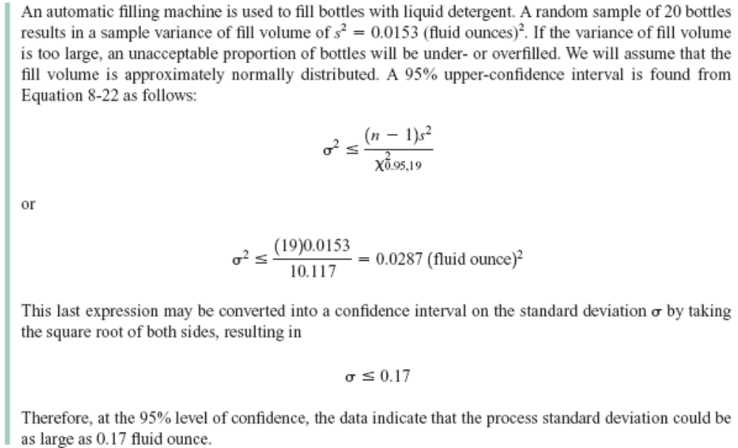
8-4 Confidence Interval on the Variance and Standard Deviation of a Normal Distribution
Example 8-6

Slide 30
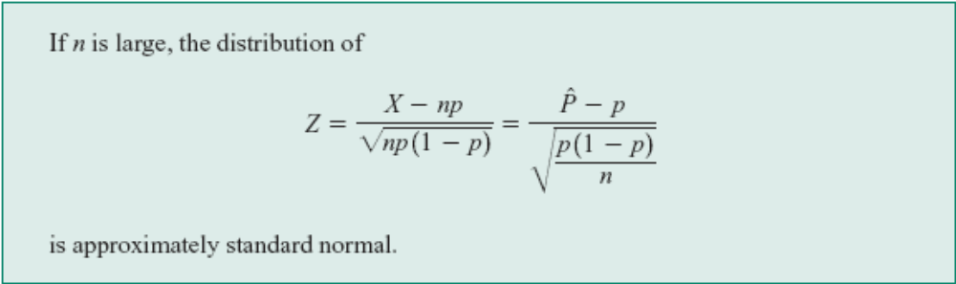


8-5 A Large-Sample Confidence Interval For a Population Proportion
Normal Approximation for Binomial Proportion
The quantity is called the standard error of the point estimator .

Slide 31
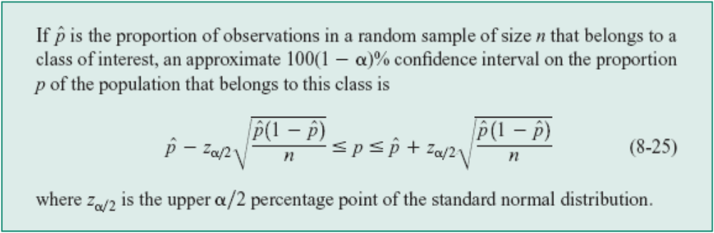
8-5 A Large-Sample Confidence Interval For a Population Proportion

Slide 32
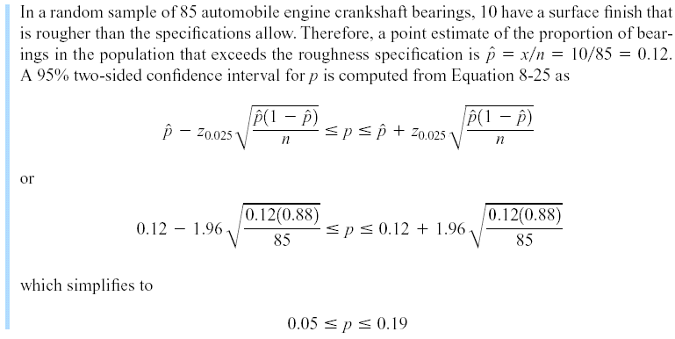
8-5 A Large-Sample Confidence Interval For a Population Proportion
Example 8-7
Notes:
Crankshaft: tay quay
Rough: gho ghe

Slide 33
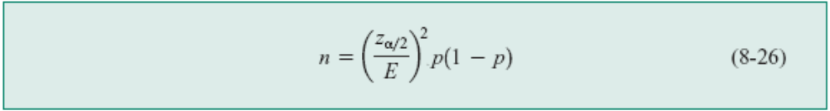
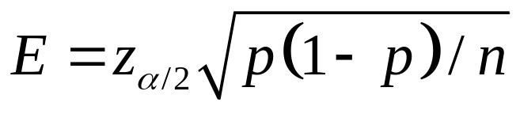
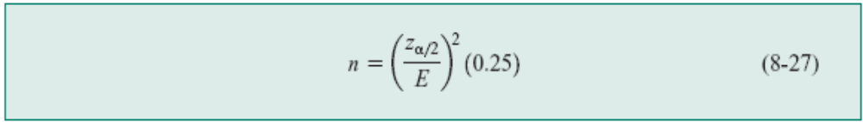
8-5 A Large-Sample Confidence Interval For a Population Proportion
Choice of Sample Size
The sample size for a specified value E is given by
An upper bound on n is given by

Slide 34
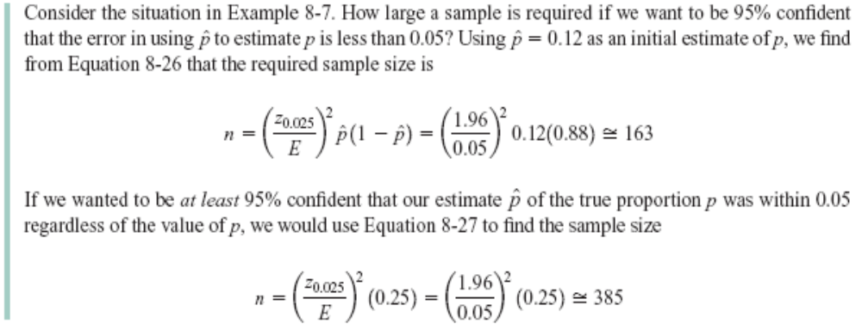
8-5 A Large-Sample Confidence Interval For a Population Proportion
Example 8-8

Slide 35
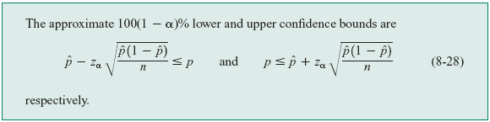
8-5 A Large-Sample Confidence Interval For a Population Proportion
One-Sided Confidence Bounds

Slide 36

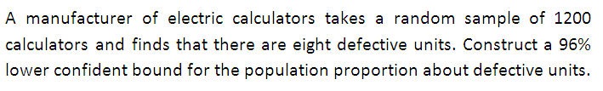

Slide 37
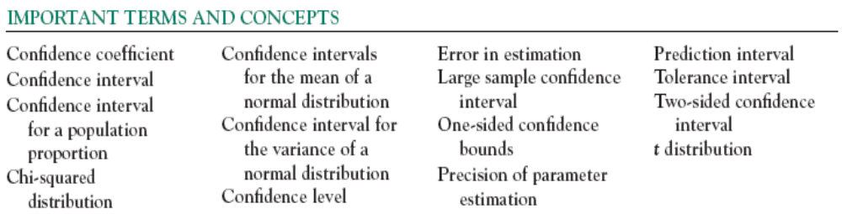

Slide 38
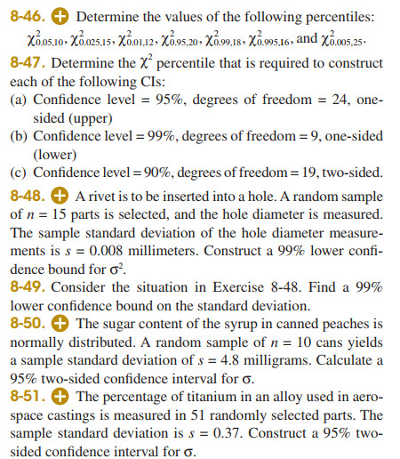


Slide 41
